Slide 1
Java Servlets 3.0
Lesson 10: Session Tracking
Notes:
Add instructor notes here.

Slide 2
Lesson Objectives
In this lesson, we will learn:
Introduction and Need for Session Management
Different Techniques of Session Tracking
Best Practices
Notes:
Lesson Objectives:
This lesson introduces Session Management. The lesson contents are:
Lesson 08: Session Management
8.1: Introduction and Need for Session Management
8.2: Different Techniques of Session Tracking
8.3: Best Practices
Explain the lesson coverage

Slide 3
10.1: Introduction and Need for Session Tracking What is a Session?
A session is the duration from which a client connects to a server till the client disconnects from that server where the user might access/view multiple pages.
A session is specific to an application as well as a user
Session begins with either of the following:
The first connection to an application by a client
The client logs-in for authenticated sessions
Session ends after either of the following:
That client’s last connection
That client logs-out
A time-out period of inactivity
Notes:
Introducing Session Tracking:
A session refers to all the connections that a single client might make to a server in the course of viewing any pages associated with a given application.
Sessions are specific to both the individual user and the application. Therefore every user of an application has a separate session. The user has access to a separate set of session variables.
Logically a session begins with the first connection to an application by a client and ends after that client’s last connection.
Session can be an authenticated session also where a user has to log-in. In this case, sessions begin when the user logs in and ends when the user log-out.
Session also ends after a time-out period of inactivity.
Ask this question to the class.
Most of the participants will answer “Duration from the time user logs in till he logs off” which is not completely true.
Do not display the bulleted point which is the correct answer.
To justify the answer, explain sites like e-newspapers, booksonline which do not require log in but still user can see the same long alphanumeric string in address bar across all the pages on that site.

Slide 4
10.1 : Introduction and Need for Session Tracking What is Session Tracking?
Session tracking implies maintaining client specific information on the server across multiple requests during the session
For example: Any Online Shopping application saves the state of a user’s shopping cart across the requests
Notes:
Introducing Session Tracking:
What is Session Tracking?
In Session tracking, client first makes a request for any servlet or any page, the container receives the request.
The container then generates a unique identification, called Session ID, for that client and gives it back to the client along with the response. This ID gets stores on the client machine. Thereafter when the client sends a request again to the server, it also sends the session Id with the request. The container sees the Id and sends back the response. While seeing the ID the container recognizes that it is the same previous client making a request.
Thus container identifies the client.
Explain the scenario of online shopping, what would happen if the client’s state was not maintained on the server ? What would be the content of the cart while order is processed.
Banking example also can be given with respect to the multiple transactions by the same account holder.

Slide 5
10.1 : Introduction and Need for Session Tracking Why Session Tracking?
Session tracking is desirable due to the following reasons:
HTTP is stateless protocol.
In HTTP communication, client makes a connection to the server, sends the request, gets the response and closes the connection.
Notes:
Introducing Session Tracking:
Why Session Tracking?
HTTP is a stateless protocol, that is it cannot persist the information.
HTTP always treats each request as a new request. Each request made by a Web browser (client), for an image, an HTML page, or other Web object, is made via a new connection. In other words, in HTTP, the client makes a connection to the server, sends the request, gets the response, and closes the connection. Hence to maintain the state across pages we need some sort of session tracking mechanism.
Explain reason behind session tracking. Exhibit that Http is a stateless protocol and thus the need for session tracking

Slide 6
10.2: Different Techniques for Session Management Session Tracking Techniques
There are several techniques of session tracking in JEE :
Hidden Form Fields
URL Rewriting
Cookies
Session Tracking API
Notes:
Ways of Session Tracking in JEE:
Session Tracking Techniques:
From the last slide we understand that since HTTP is stateless protocol it becomes developer’s job to work around saving client specific information on server in a web application.
There are several ways in which session tracking can be done in JEE.
Hidden Form Fields: It is the simplest way of saving user-specific information where hidden parameters are encoded inside an HTML form, such as the username and type of transaction being made
URL Rewriting: URL rewriting involves placing a session id in the URL.
Cookies: It is a small text file storing client information, cookies are created by the server and saved on client’s machine.
Session Tracking API: Servlets API provides Session Tracking API
List the Session tracking techniques with a brief explanation. Tell participants that detailed explanation is in the following slides and we shall be seeing some of these in demos later.

Slide 7
10.2: Different Techniques for Session Management Hidden Form Fields
Hidden Form fields are fields added to an HTML form that are not displayed in the client’s browser.
They are sent back to the server when the form that contains them is submitted
Hidden fields are supported in all the popular browser, they demand no special server requirements, and they can be used with clients that haven’t registered or logged.
The major disadvantage of this technique is that it works only for a sequence of dynamically generated forms.
Notes:
Ways of Session Tracking in JEE:
Hidden Form Fields:
In this technique the fields are added to an HTML form which are not displayed in the client’s request. The hidden form fields are sent back to the server when the form is submitted. In hidden form fields, the HTML entry will be as shown below:
This means that when form is submitted ,the specified name and value will be get included in get or post method.
Convey this is oldest and the simplest way of session tracking. Point out the disadvantage. Briefly explain small html fragment from the notes

Slide 8
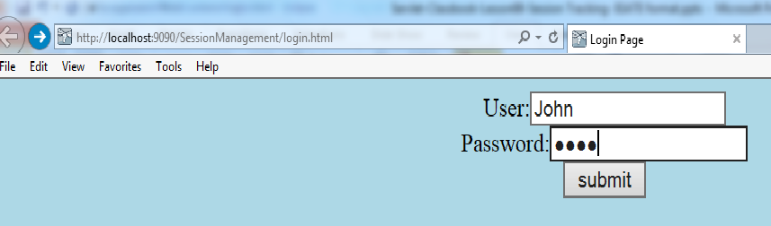
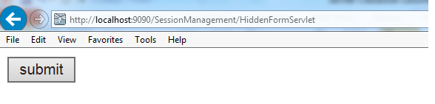
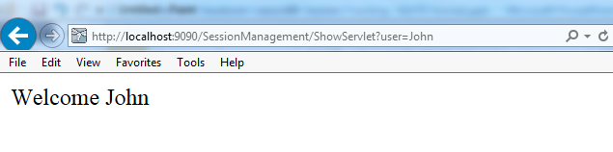
10.2: Different Techniques for Session Management Demo
Execute the following login.html, HiddenFormServlet, ShowServlet
Notes:
Execute the following servlets:
http://localhost:9090/SessionManagement/login.html
This would lead to servlet:
http://localhost:9090/SessionManagement/HiddenFormServlet
In HiddenFormServlet, username is added as Hidden Field in html form as shown below in partial listing.
out.println("<form action='ShowServlet'>");
out.println("<input type='hidden' name='user' value='" + user + "'>");
out.println("<input type='submit' value='submit' >");
Then username is retrieved in ShowServlet.
http://localhost:9090/SessionManagement/ShowServlet?user=John.
Query parameters get appended due to the GET method.

Slide 9
10.2: Different Techniques for Session Management URL Rewriting
URL rewriting is another way to support anonymous session tracking.
With URL rewriting, every local URL the user might click on is dynamically modified, or rewritten, to include extra information.
The extra information can be in the form of extra path information, added parameters, or some custom, server-specific URL.
Due to the limited space available in rewriting a URL, the extra information is limited to a unique session ID
Notes:
Ways of Session Tracking in JEE:
URL Rewriting:
The explanation for session Id would be covered in the HttpSession section.
URL rewriting is another way to support anonymous session tracking. With URL rewriting, every local URL the user might click on is dynamically modified, or rewritten, to include extra information. The extra information can be in the form of extra path information, added parameters, or some custom, server-specific URL. Due to the limited space available in rewriting a URL, the extra information is limited to a unique session ID. For example, the following URLs have been rewritten to pass session id 123:
Original URL :
http://server:port/servlet/Rewritten
Extra path information :
http://server:port/servlet/Rewritten/123
Added parameter :
http://server:port/servlet/Rewritten?sessionid=123
Added parameter change :
http://server:port/servlet/Rewritten;$sessionid$123
Each rewriting technique has its advantages and disadvantages. Using extra path information works on all servers, and it works as a target for forms that use both the GET and POST methods. It doesn’t work well if a servlet has to use the extra path information as true path information.
An added parameter works on all servers too, but fails as a target for forms those uses the POST method, and it causes parameter-naming collisions.
Using a custom, server-specific change works under all conditions for servers that support the change. Unfortunately, it doesn’t work at all servers that don’t support the change.
Ask to give one example of URL. Give one real life example which we notice in address bar of the browser while surfing net day-to-day. Point out the number of characters limitation in URL

Slide 10
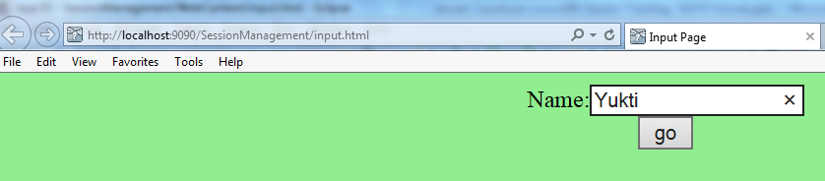
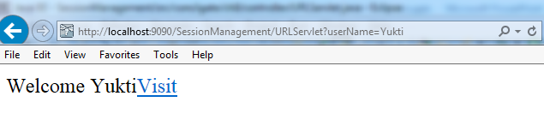
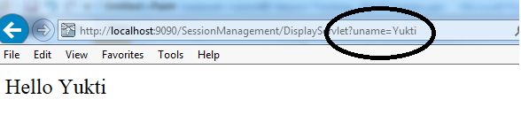
10.2: Different Techniques for Session Management Demo
Execute the following input.html, URLServlet, DisplayServlet
Notes:
Execute the following servlets:
http://localhost:9090/SessionManagement/input.html
This would lead to servlet:
http://localhost:9090/SessionManagement/URLServlet
In URLServlet, username is appended as query string as shown below in partial listing.
out.print("<a href=‘DisplayServlet?uname="+n+"'>visit</a>");
Then username is retrieved in DisplayServlet.
http://localhost:9090/SessionManagement/DisplayServlet?user=Yukti.

Slide 11
10.2: Different Techniques for Session Management Cookies
Cookie is a small text file containing client information sent by a web server to a browser that can later be read back from the browser.
When a browser receives a cookie, it saves the cookie and thereafter sends the cookie back to the server each time it accesses a page on that server, subject to certain rules.
Since cookie’s value can uniquely identify a client, cookies are often used for session tracking.
Notes:
Ways of Session Tracking in JEE:
Cookies:
Cookie is a bit of information stored in a small text file sent by a web server to a browser that can later be read back from the browser. When a browser receives a cookie, it saves the cookie and there-after sends the cookie back to the server each time it accesses a page on that server, subject to certain rules. Since cookie’s value can uniquely identify a client, cookies are often used for session tracking.
The browser is expected to support 20 cookies for each Web server, 300 cookies total, and may limit cookie size to 4 KB each.
Get the answer from participants before explanation about cookies. Now correct them. If possible show the location of cookies on the machine.
Point out : Cookies may not be supported by all the browsers, accepting-not accepting, ask before accepting cookies can be set in the browser

Slide 12
10.2: Different Techniques for Session Management Working with Cookies
Cookie can be created using Cookie class which is in the package javax.servlet.http.Cookie.
To create cookie use Cookie class constructor:
public Cookie(String name, String Value)
Once the cookie is created, send the cookie to the browser using the following method:
HttpServletResponse.addCookie(Cookie cookie)
Cookies can be retrieved by servlet from a request by using the following method:
HttpServletRequest.getCookies()
Notes:
Ways of Session Tracking in JEE:
Working with Cookies
Create a cookie with the Cookie( ) constructor:
public Cookie( String name, String value )
This creates a new cookie with an initial name and value. A cookie has a name, a single value, and optional attributes such as a comment, path and domain qualifiers, a maximum age, and a version number.
The name of the cookie must be an HTTP/1.1 token. Tokens are strings that contain none of the special characters listed in. (Alphanumeric strings qualify as tokens.)
The value of the cookie can be any string, though null values are not guaranteed to work the same way on all browsers. In addition, if a cookie is sent that complies with Netscape's original cookie specification, do not use whitespace or any of these characters:
[ ] ( ) = , " / ? @ : ;
A servlet can send a cookie to client by passing a Cookie object to the addCookie( ) method of HttpServletResponse:
public void HttpServletResponse.addCookie(Cookie cookie)
The method adds the specified cookie to the response. Additional cookies can be added with subsequent calls to addCookie( ).
Explain creating cookies in 3 steps to make it easy. Creating cookie, setting the age, adding cookie.
Explain retrieval of cookies and mention it returns an array by reiterating that a site can support up to 20 cookies.

Slide 13
10.2: Different Techniques for Session Management Working with Cookies : An example
Cookie[] cookies = req.getCookies();
if (cookies != null) {
for (int i = 0; i < cookies.length; i++) {
if (cookies[i].getName().equals("sessionid")) {
String name =cookies[i].getName();
String value =cookies[i].getValue();
}
}
}
Notes:
Ways of Session Tracking in JEE:
Working with Cookies:
Since cookies are sent using HTTP headers, they should be added to response before any content is sent.
The code to set a cookie looks like this:
A servlet retrieves cookies by calling the getCookies( ) method of HttpServletRequest.
This method returns an array of Cookie objects that contains all the cookies sent by the browser as part of the request or null if no cookies were sent. Several cookies might have the same name but different path attributes. The code to fetch the cookies looks like this:
Cookie[] cookies = req.getCookies();
if (cookies != null) {
for (int i = 0; i < cookies.length; i++) {
if (cookies[i].getName().equals("sessionid")) {
String name =cookies[i].getName();
String value =cookies[i].getValue();
}
}
}
Cookie cookie=new Cookie(“ID” , “123” );
res.addCookie(cookie);
public Cookies[ ] HttpServletRequest.getCookies( )
Explain methods like set-get MaxAge, getValue, getName. Other methods ask them to go through docs

Slide 14
10.2: Different Techniques for Session Management Cookie Methods
Let us discuss some prominent cookie methods:
public void setComment(java.lang.String purpose)
public java.lang.String getComment()
public void setDomain(java.lang.String pattern)
public java.lang.String getDomain()
public void setMaxAge(int expiry)
public int getMaxAge()
public void setPath(java.lang.String uri)
public java.lang.String getPath()
public void setSecure(boolean flag)
Notes:
Ways of Session Tracking in JEE:
Cookie Methods:
public void setComment(java.lang.String purpose) :
It specifies a comment that describes a cookie's purpose.
public java.lang.String getComment() :
It returns the comment describing the purpose of this cookie, or null if the cookie has no comment.
public void setDomain(java.lang.String pattern) :
It specifies the domain within which this cookie should be presented.
public java.lang.String getDomain() :
It returns the domain name set for this cookie.
public void setMaxAge(int expiry) :
It sets the maximum age of the cookie in seconds. A positive value indicates that the cookie will expire after that many seconds have passed. Note that the value is the maximum age when the cookie will expire, not the cookie's current age. A negative value means that the cookie is not stored persistently and will be deleted when the Web browser exits. A zero value causes the cookie to be deleted.
public int getMaxAge() :
It returns the maximum age of the cookie, specified in seconds. If getMaxAge returns a negative value, the cookie was not stored persistently. This method does not return a zero value, because if a cookie's age was set to zero with setMaxAge, the cookie was deleted.
Run the servlet after explaining the code. Show the cookie that has got stored on the machine. Also open the file and show content of that file.

Slide 15
10.2: Different Techniques for Session Management Cookie Methods
public java.lang.String getName()
public void setValue(java.lang.String newValue)
public java.lang.String getValue()
public int getVersion()
public void setVersion(int v)
Notes:
Ways of Session Tracking in JEE:
Cookie Methods:
public void setPath(java.lang.String uri)
It specifies a path for the cookie, which is the set of URIs to which the client should return the cookie. The cookie is visible to all the pages in the directory being specified, and all the pages in that directory's subdirectories. A cookie's path must include the servlet that set the cookie, for example, servlet/dir1, which makes the cookie visible to all directories on the server under dir1.
public java.lang.String getPath()
It returns the paths (that is, URIs) on the server to which the browser returns this cookie. The cookie is visible to all subdirectories within the specified path on the server.
public void setSecure(boolean flag)
It indicates to the browser whether the cookie should only be sent using a secure protocol, such as HTTPS or SSL. This method should only be used when the cookie's originating server used a secure protocol to set the cookie's value. The default value is false.
public boolean getSecure()
It returns true if the browser is sending cookies only over a secure protocol, or false if the browser can use a standard protocol.

Slide 16
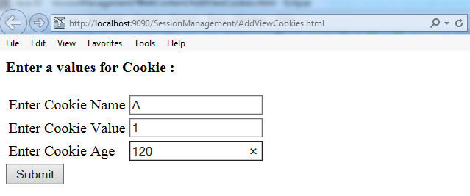
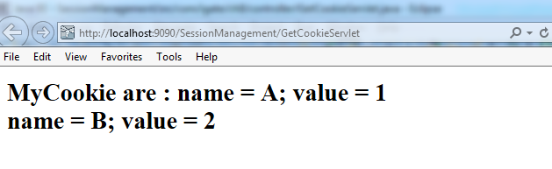
Demo
Creating and retrieving cookies:
AddCookieServlet Code
GetCookieServlet Code
AddViewCookies html page
Notes:
Note:
Refer to the com.igate.ch8.controller.AddCookieServlet.java code, partial listing of doGet() is given here:
Partial code for com.igate.ch8.controller.GetCookieServlet is here :
Cookie cookie = new Cookie(name,data);
if ((age==null) || (age.equals(""))) {
res.addCookie(cookie);
out.println("Set Cookie --- Name= " + name + " Value = " + data);}
else { try { int intage=Integer.parseInt(age);
cookie.setMaxAge(intage);
res.addCookie(cookie);
out.println("Set Cookie --- Name= " + name + " Value = " + data + " age= "+age );
} catch(Exception e) { out.println("Exception " +e; }
}
Cookie[] cookies = req.getCookies();
out.println("<B>MyCookie are : ");
for(int i=0;i < cookies.length;i++) {
String name = cookies[i].getName();
String value = cookies[i].getValue();
out.println("name = " + name + "; value = " + value +"<BR>"); }

Slide 17
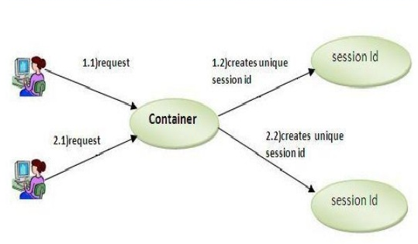
10.2: Different Techniques for Session Management Session Tracking API
Servlet API provides HttpSession interface in javax.servlet.http package to track and manage sessions
HttpSession interface provides a way to identify a user across more than one page request or visit to a Web site and to store information about that user
A session usually corresponds to one user, who may visit a site many times
Notes:
Ways of Session Tracking in JEE:
Session Tracking API:
One of the ways to track session is by using Session Tracking interfaces provided by Servlet API.
The API provides HttpSession interface to track and manage sessions.
The servlet container uses this interface to create a session between an HTTP client and an HTTP server creating an unique identifier called Session ID. The server can maintain a session in many ways such as using cookies or rewriting URLs. This interface allows servlets to view and manipulate information about a session, such as the session identifier, creation time, and last accessed time.
The explanation about Session Id would be explained in the next subsequent slide.
Make them open the docs and show Servlet API. Point our two interfaces mentioned here.
Tell them we will be seeing what is managing sessions in following slides.

Slide 18
10.2:Different Techniques for Session Management Session Tracking API - Using HttpSession
HttpSession interface provides methods for session tracking. They are:
public HttpSession HttpServetRequest.getSession(boolean create)
public void HttpSession.setAttribute(String name, Object value)
java.lang.Object HttpSession.getAttribute(String name)
public void HttpSession.removeAttribute(String name)
public String HttpSession.getId()
Notes:
Ways of Session Tracking in JEE:
Session Tracking API - Using HttpSession:
public HttpSession HttpServetRequest.getSession(boolean create) : retrieve the current HttpSession object. This method returns the current HttpSession object associated with the request or, if necessary, create a new session for the request. Use true to create a new session if none exists.
If create is false, and the request has no valid session then this method returns null else returns the existing session. To make sure the session is properly maintained, need to call this method at least once before writing any output to the response.
public void HttpSession.setAttribute(String name, Object value) :add information in form of an object to session object. This method binds an object to this session, using the name specified. If an object of the same name is already bound to the session, the object is replaced. The putValue() method is sometimes used instead of setAttribute() however it is deprecated now.
public Object HttpSession.getAttribute(String name) : retrieve information object stored by setAttribute() method in form of an object from the session. Returns null if no object of that name exists.
public java.lang.String getId() : This method returns a string containing the unique identifier assigned to this session. The identifier is assigned by the servlet engine and is implementation dependent.
Tell them getSession() is method of HttpServletRequest interface.
Mention that getAttribute always returns an Object which is needed to be type casted if not a String

Slide 19
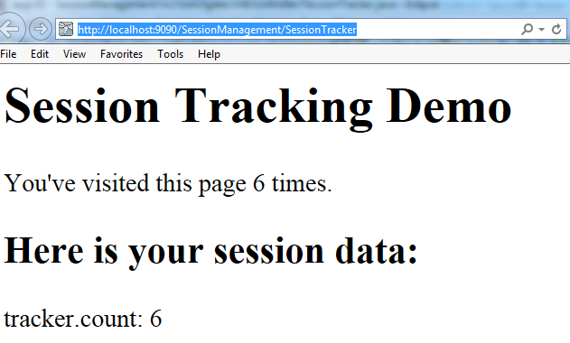
Demo
Session tracking to count the number of times a client has accessed the site:
SessionTracker.java servlet
Notes:
Note:
Refer the com.igate.ch8.controller.SessionTracker.java code; partial listing of doGet() method is given:
// Get the current session object, create one if necessary
HttpSession session = req.getSession(true);
// Increment the hit count for this page. The value is saved
// in this client's session under the name "tracker.count".
Integer count = (Integer)session.getAttribute("tracker.count");
if (count == null) {
count = new Integer(1); }
else {
count = new Integer(count.intValue() + 1); }
session.setAttribute("tracker.count", count);
out.println("<HTML><HEAD><TITLE>SessionTracker</TITLE></HEAD>");
out.println("<BODY><H1>Session Tracking Demo</H1>");
// Display the hit count for this page
out.println("You've visited this page " + count +
((count.intValue() == 1) ? " time." : " times."));
out.println("<P>");
out.println("<H2>Here is your session data:</H2>");
String[] names = session.getAttributeNames();
for (int i = 0; i < names.length; i++) {
out.println(names[i] + ": " + session.getAttribute(names[i]) + "<BR>"); }
out.println("</BODY></HTML>");
Run the given servlets
Relate to type casting as explained in previous slide by pointing to the code.

Slide 20
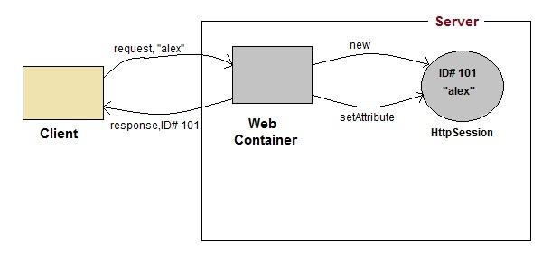
10.2: Different Techniques for Session Management Session Tracking API – Using Session ID
When a user first accesses the site, is assigned a new HttpSession object and a unique session ID.
Session ID: It identifies the user and is used to associate the user with HttpSession object in subsequent requests.
Session id is appended to the URL for session tracking using URL rewriting.
Notes:
Ways of Session Tracking in JEE:
Session Tracking API – Using Session ID:
When a user first accesses the site, that user is assigned a new HttpSession object and a unique session ID. The Session ID identifies the user and is used to the user with HttpSession object in subsequent requests. Behind the scenes, the session ID is usually saved on the client in a cookie or sent as part of a rewritten URL.
A server can discover session’s ID with the getID() method seen earlier.
It returns a string containing the unique identifier assigned to this session. The identifier is assigned by the servlet engine and is implementation dependent. This method throws an IllegalStateException if session is invalid.
Make participants open any site and show them the “long alphanumeric string” to explain session ID. Explain when is created and by whom.

Slide 21
10.2: Different Techniques for Session Management Session Tracking API – Using Session ID
Two methods to encode URL:
public java.lang.String encodeURL(java.lang.String url)
public java.lang.String encodeRedirectURL(java.lang.String url)
Notes:
Session Tracking API:
Session Id is stored as part of URL to support session tracking via URL rewriting. Servlet rewrites every local URL before sending it to the client. The Servlet API’s HttpServletRequest interface provides two methods to perform this encoding:
public java.lang.String encodeURL(java.lang.String url)
It encodes the specified URL by including the session ID in it, or, if encoding is not needed, returns the URL unchanged. The implementation of this method should include the logic to determine whether the session ID needs to be encoded in the URL. For example, if the browser supports cookies, or session tracking is turned off, URL encoding is unnecessary.
All URLs emitted by a Servlet should be run through this method. Otherwise, URL rewriting cannot be used with browsers, which do not support cookies.

Slide 22
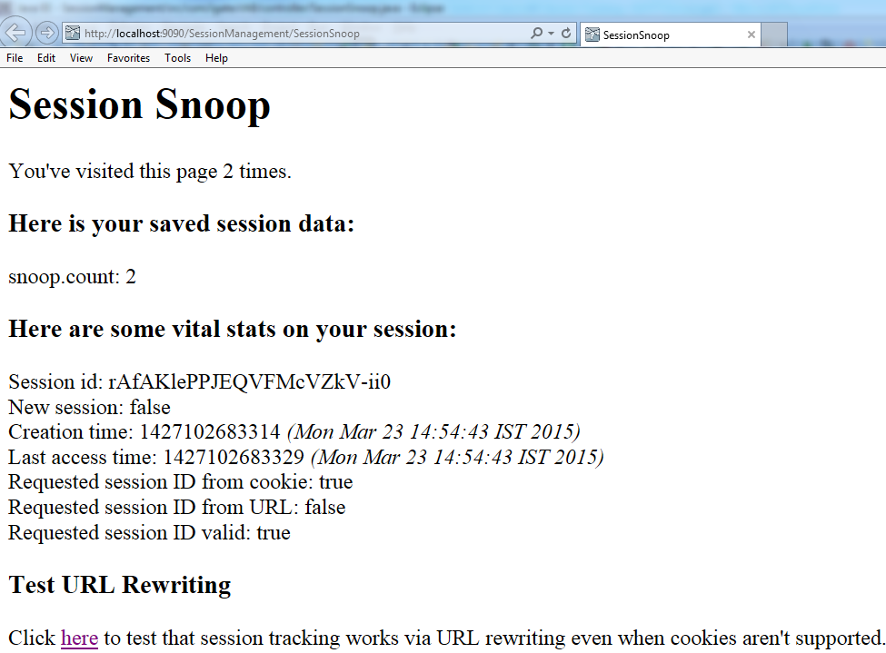
Demo
Execute the servlet which gets Session Information using HttpSession & URL Rewriting
Sessionsnoop servlet
Notes:
Note:
Refer to com.igate.ch8.controller.SessionSnoop.java servlet code; partial code in doGet() method is here :
out.println("<H3>Here are some vital stats on your session:</H3>");
out.println("Session id: " + session.getId() + "<BR>");
out.println("New session: " + session.isNew() + "<BR>");
out.println("Creation time: " + session.getCreationTime());
out.println("<I>(" + new Date(session.getCreationTime()) + ")</I><BR>");
out.println("Last access time: " + session.getLastAccessedTime());
out.println("<I>(" + new Date(session.getLastAccessedTime()) + ")</I><BR>");
out.println("Requested session ID from cookie: " +req.isRequestedSessionIdFromCookie() + "<BR>");
out.println("Requested session ID from URL: " + req.isRequestedSessionIdFromURL() + "<BR>");
out.println("Requested session ID valid: " + req.isRequestedSessionIdValid() + "<BR>");
out.println("<H3>Test URL Rewriting</H3>");
out.println("Click <A HREF=\"" +
res.encodeURL(req.getRequestURI()) + "\">here</A>");
out.println("to test that session tracking works via URL");
out.println("rewriting even when cookies aren't supported.");
out.println("</BODY></HTML>");
Run the given servlets. Explain the code…

Slide 23
Demo
Execute a servlet that manually invalidates a session if it is more than a day old or has been inactive for more than an hour.
Manual Invalidate servlet
Notes:
Note:
Refer to com.igate.ch8.controller.ManualInvalidate.java servlet code; partial code of doGet() method is given here:
// Get the current session object, create one if necessary
HttpSession session = req.getSession(true);
// Invalidate the session if it's more than a day old or has been
// inactive for more than an hour.
if (!session.isNew()) { // skip new sessions
Date dayAgo = new Date(System.currentTimeMillis() - 24*60*60*1000);
Date hourAgo = new Date(System.currentTimeMillis() - 60*60*1000);
Date created = new Date(session.getCreationTime());
Date accessed = new Date(session.getLastAccessedTime());
if (created.before(dayAgo) || accessed.before(hourAgo)) {
session.invalidate();
session = req.getSession(true); // get a new session
}
Run the given servlets. Explain the code…

Slide 24
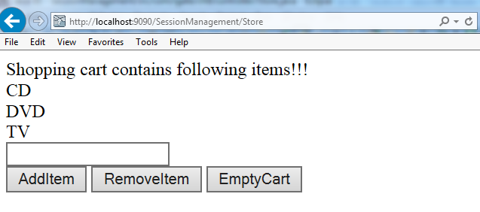
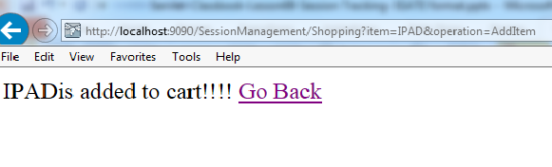
Demo
This is a simple shopping cart example: Store.java and Shopping.java
Notes:
Note:
Execute Servlets:
http://localhost:9090/SessionManagement/Store
This servlet maintains a list of shopping items
http://localhost:9090/SessionManagement/Shopping?item=CD&operation=AddItem
This servlet does different operations like adding item to cart, removing item from cart and making the cart as empty.
Explain the code and execute servlet.

Slide 25
10.3: Best Practices Best Practices in Session Tracking
An application that uses URL rewriting to track sessions must adhere to certain programming guidelines as URL rewriting has high security risks.
The application developer needs to:
Program session servlets to encode URLs
Supply a servlet or JSP file as an entry point to the application
Avoid using plain HTML files in the application
All emitted links must be consistently rewritten

Slide 26
Lab: Session Management
Lab 6.1

Slide 27
Summary
In this lesson, we have learnt:
The concept of Session Tracking
Session Tracking Techniques
Notes:
Summarize the chapter by briefly mentioning what all is learnt.

Slide 28
Review Questions
Question 1: Web Application developer needs to maintain client’s state on server because:
Option 1: To remind client of his information
Option 2: Http is a stateless protocol
Option 3: Http is unreliable protocol
Option 4: No need as its taken care of by the Http Server
Question 2: Browsers required to accept ___ cookies per site:
Option 1: 1
Option 2: 40
Option 3: 20
Option 4: unlimited
Notes:
Answers for the Review Questions:
Answer 1: Http is stateless protocol
Answer 2: 20

Slide 29
Review Questions
Question 3: ___ method is used to end the session
Option 1: invalidate()
Option 2: logout()
Option 3: invalidSession()
Question 4: Global timeout for all the sessions is maintained by.
Option 1: HttpSession.setMaxInactiveInterval(600)
Option 2: iHttpSession.logout(600)
Option 3: mapping in web.xml
Option 4: All Options are true
Notes:
Answers for the Review Questions:
Answer 3: invalidate()
Answer 4: mapping in web.xml

